Slide 1
I Didn’t Know I Could Do That with NxEdit
Notes:
I am a keyboard person and use the mouse as little as possible. I find that I can work much more quickly and accurately and I have much less wrist and hand pain.
So throughout this presentation I’ll be referencing keystrokes where possible. Some actions aren’t even possible with the mouse only and some I just don’t know how with the mouse. There are a few things you have to do with the mouse, though.

Slide 2
Standard keyboard behaviour
Many keys behave pretty much as they do in other Windows apps.
Arrows, PgUp, PgDn, End, Home, etc.
Home goes to beginning of text on a line.
Home again goes to the first column of the line.
Ctrl-Right Arrow / Ctrl-Left Arrow: go to beginning of the next/previous word.
Ctrl-Z / Shift-Ctrl-Z: Undo or Redo an edit.
Notes:
NxEdit is a windows app so most keystrokes behave the same as usual.

Slide 3
Special Moves
There are also many special movements
History kept just like your web browser
Alt-LeftArrow: takes you back to your previous location
Alt-RightArrow: after going back this goes forward
F5 / Shift-F5 : Go to the Next/Previous changed line
Ctrl-O / Shift-Ctrl-O: Go to Next/Previous syntax error.
Ctrl-J: go to sequence number
There are several others
Notes:
There are several special ways to move around in the document that are unique to NxEdit or other source code editors.
One cool one is the history of recent edit locations. You can go back to previous locations with the Alt-BackArrow just like your web browser.
There are also quick ways to move to the next or previous record that has been changed, to the next record flagged with a syntax error, or jump directly to a sequenced line.

Slide 4
Matching Brackets
Matching Brackets, Braces, Parentheses and BEGIN/ENDs
Place cursor right before or within an area delimited by “( ) { } [ ] begin end” pairs
Alt-] moves forward to the item that matches the beginning delimiter
Alt-[ moves to the beginning
Notes:
One of my favourite editing tools. Especially when you have a missing or extra “begin” or “end”.
I’ve seen other editors that highlight the matching delimiter. This one doesn’t do that but it will move you there.

Slide 5
Bookmarks
Set bookmarks to important parts
Set each bookmark with Ctrl-M
You will be asked to name it.
Now you can move among them
F6 to move to next
Shift-F6 to move to previous
There is also a window with a list of bookmarks.
Ctrl-Alt-M
Notes:
Bookmarks are also handy. Just put the cursor on a line, hit Ctrl-M. The name is prefilled with the word under the cursor or the high-lighted text. You may overwrite it. Then hit Enter.
Moving between them is easy. Just hit F6 or Shift-F6.

Slide 6
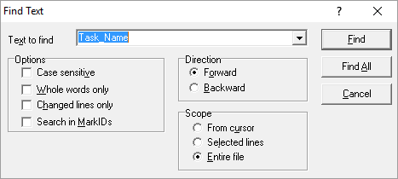
Finding
To find a word
Ctrl-F
If the cursor was at or on a word then the word is selected, otherwise you must type it in
Select your options and hit Enter to find the first instance or Alt-A to find all.
Hit F3 to find the next
Shift-F3 to find the previous
Notes:
Finding a word or phrase is easy. If some text is selected or the cursor is on or at a word “Text to find” box is prefilled.
Hitting “Find All” creates a nice list in the output window without moving the cursor. You can then double-click on each to jump to that line.

Slide 7
Selecting text
How to select text with the keyboard
Hold the Shift key and move around with the Arrows, PgUp, PgDn, etc. (This works with all standard Windows apps).
To select several complete lines
Hit Ctrl-K
Move to end or beginning
Hit Ctrl-K again
To select the current line
Hit Ctrl-K twice.
Notes:
This works the same in all windows apps but doesn’t seem to be well known. To select text just hold the shift key and use the arrows. Must easier and more accurate than the mouse.
Ctrl-K harkens back to the old TurboC editor. The “K” stands for mar”K” bloc”K”.

Slide 8
Selecting a block (E.g. Procedure)
Selecting a delimited block of text. Perhaps it’s several hundred or several thousand lines long.
Select first line of procedure with Ctrl-K
Move down to “BEGIN”
Hit Alt-] (it will move to “END”)
Hit Ctrl-K
Notes:
This combines selecting a line with finding a matching delimiter.
Hit Ctrl-K where you want to start then use the find matching key Alt-] to find the end.
You can use other methods to select the second line. It can even be before the first line.

Slide 9
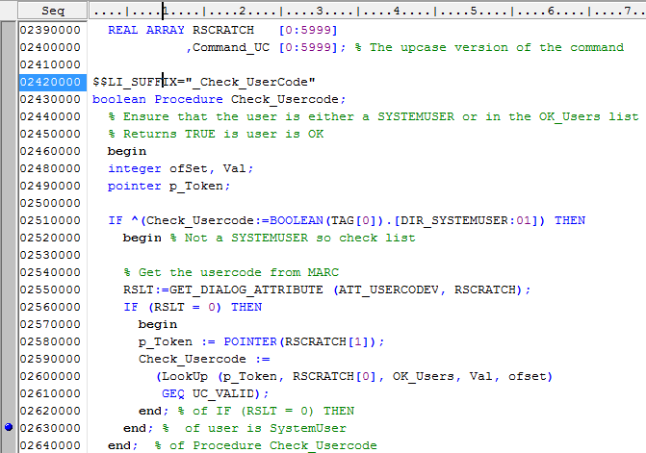
Select a block - step 1
Cursor on this line. Press Ctrl-K
Notes:
Here is an example of selecting a block, in this case a procedure.
We position our cursor on the first line we want and press Ctrl-K.

Slide 10
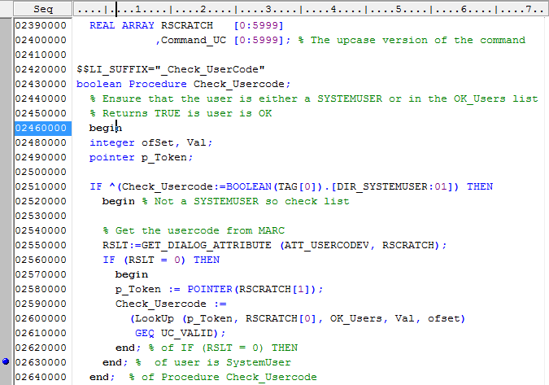
Select a block – step 2
Cursor on this line. Press Alt-]
Notes:
Now go to the start of the enclosure. This is the “begin”. Hit Alt-] .

Slide 11
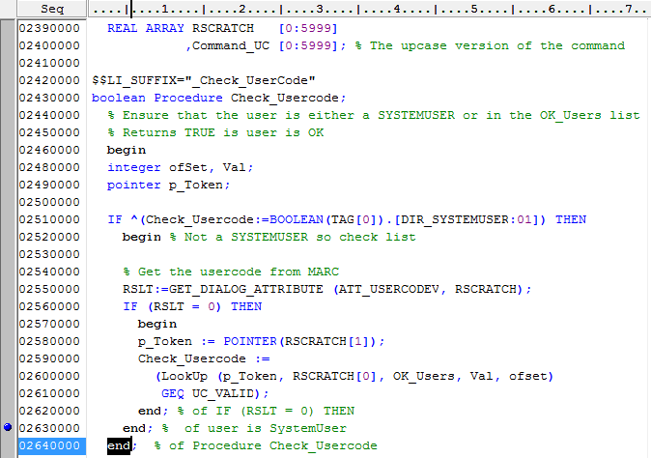
Select a block - step 3
Now at the end. Press Ctrl-K again.
Notes:
The Alt-] moved the cursor to the matching “end”.
Hit Ctrl-K again.

Slide 12
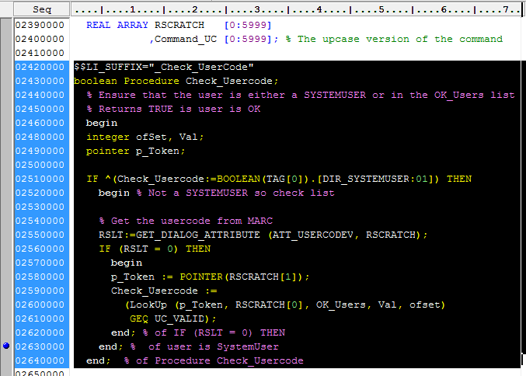
Select a block – done.
Entire block is selected. Now you can cut, copy, delete, etc.
Notes:
Your block is now selected.
We can use whatever mechanism we like to position the cursor for the seconds Ctrl-K.
For example we could have used the F6 key to move to the next bookmark and then hit the Ctrl-K.

Slide 13
Indents and Upper/Lower case
To indent/un-indent several lines
Select text spanning multiple lines.
Hit Tab or Shift-Tab to indent or unindent.
To change the case of a selection
To CONVERT TO UPPER CASE - Ctrl-U
To convert to lower case – Ctrl-L
To Convert To Start Case – Ctrl-T
Notes:
Here are a couple of shortcuts for handling text.
Select some text spanning multiple lines and indent or unindent them.
Changing case is easy, too.
Does anyone know where the terms lowercase and upper case came from?

Slide 14
Replacing
Ctrl-R
Replacing works similarly to other other apps.
Notes:
Not much to say about this. It works pretty much as you would expect it to.

Slide 15
Compiling and running
A couple of shortcuts for compiling and running
Ctrl-F9 : Compiles the program
F9 : Runs the program. If necessary it will compile it first.
F2 : Runs the program with TADS. If necessary it will compile it first.
Ctrl-F2 : Kills the program if it’s running.
Notes:
Here are some handy shortcuts for compiling and running.

Slide 16
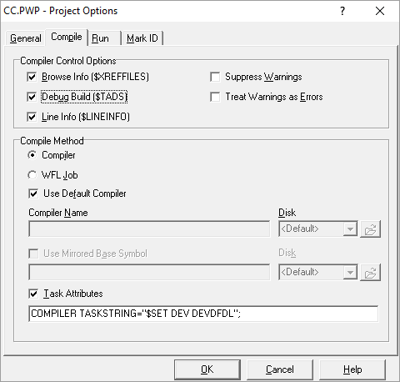
Debugging
Setup
Set the compile options
Menu item: Tools
Project Options
Ensure the $TADS option is checked.
Notes:
Before we can debug a program interactively we need to setup the compile options.
The important thing is to set TADS.
Note that you can also put stuff in the task attributes that will affect either the compiler or the object code file.

Slide 17
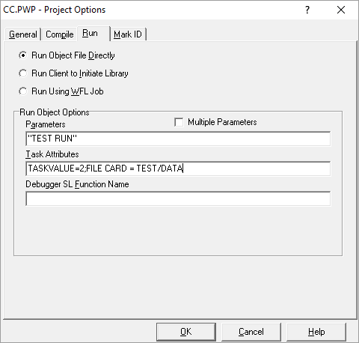
Debugging
Setup
Run-time options
File equates
Task Value
Etc.
Notes:
Also set up the attributes for when the program runs.
E.g. FILE and LIBRARY equates.

Slide 18
Debugging
Compile it
Hit Ctrl-F9
Ensure there are no syntax errors
If there are errors you can move between them with Ctrl-O / shift-Ctrl-O.
Notes:
Compile it and check for errors.

Slide 19
Debugging
RUN the program with TADS
Hit the F2 key
The program will run as if it had TADS = TRUE.
It will stop at the first executable statement
Step through the program one line at time with the F11 key.
To run a procedure call without stopping press F10
While in a procedure you can exit with Alt-F11
F2 will run to the next breakpoint
Set/Unset breakpoints with Ctrl-B
Use the mouse to put the cursor on a future line
Click F12 to run until that line is encountered
Ctrl-F2 stops the program
Notes:
Run the program with the F2 key.
It stops at the first executable line.
There are various keys you can use to step thru the program or run until a breakpoint.
Ensure that you keep control of it and it doesn’t run away.

Slide 20
Displaying Values
Display or alter the content of variables while running
In the Evaluate/Modify window.
From the TADS Chat window.
In the Watch List
Notes:
As you step thru the code you can view or alter the contents of variables at various points.
We’ll discuss some of the tools to do that.

Slide 21
Evaluate/Modify Window
Right click on a variable name
Select Evaluate
The Evaluate/Modify window pops up with the value of the variable.
You can dock this window for future use
You can Modify the contents of some variables on-the-fly.
Dock this window if you want to reuse it.
Notes:
A quick and easy way to view the contents of one variable one time is to right click it in the source code.
You can even alter its contents.
Dock it for reuse.

Slide 22
TADS Chat window
Hit Ctrl-Alt-T
The TADS chat window pops up
Dock it if you like.
Enter DISPLAY <variable name> (E.g. DISPLAY COUNTER_1)
Enter other normal TADS commands
STEP , WHEN etc.
Notes:
Use the TADS chat window to enter any commands you would normally give to tads.
Two interesting ones are:
* - An asterisk (*) causes all the declared program elements of the current procedure or
block to be displayed.
* * - A double asterisk (* *) causes all currently active program elements to be displayed,

Slide 23
Watchlist window
Hit Ctrl-Alt-W to open the watchlist window.
Dock it. Resize the “Expression” column.
Right-click to enter or edit expressions (E.g. QNum)
You can specify a format ( Hex, Dec, Ebc )
To see the contents of arrays enter a range or [*]
You’re supposed to be able to change values but it doesn’t work for me.
As you step through the program the values will be updated
Newly changed values are highlighted in red.
Notes:
Items in the watchlist window automatically update at each breakpoint as you step through the program.
At each step if an item has changed it is highlighted in Red.

Slide 24
Debugging Libraries
Ensure library doesn’t FREEZE(PERMANENT)
Compile your library as normal but with TADS set
Enable Break Points at the start of areas you want to debug.
From the “Run” menu select “Debug Listen”
From a terminal emulator or other means run your calling program.
When the program calls the library it will stop at the first executable statement.
Hit F2. The library will run to the first breakpoint.
Now you can step through the library as you would a stand-alone program.
Notes:
You can also debug libraries step by step and display and/or alter the content variables just as you would a stand-alone program.
Some things to watch.
Ensure that the library doesn’t freeze permanent so you don’t have to clean it up afterward.
Set Breakpoints at the beginning of the exported procedures that you want to debug.
Invoke it as you normally would.
Whenever it’s called it will behave like a normal program.
When you’re done ensure that you recompile it without TADS.

Slide 25
SYSTEM level libraries
COMS, MARC, PrintS, etc.
Same procedure as other libraries except:
The service that is using the library might be time sensitive or single threaded.
Be aware of how you might be affecting other users
What will happen if your library crashes? Will it cause the caller to crash? Will that hurt?
Where possible use a separate copy
Perhaps LIBACCESS BYTITLE, a TESTMCS, special Agenda
Your own hardware. Use your own box if you can.
Sometimes you need special attributes:
COMPILER, TASKING, PU, etc.
Notes:
You can also use this technique on SYSTEM level libraries. But there are a few extra gotcha’s to look out for.
Beware that the caller might be time-sensitive or it might be single-threaded causing grief to other users.
What will happen if your library returns an invalid result or crashes?
Can you run your own copy?
Some stuff needs special permissions.

Slide 26
Libraries Requiring Attributes
Sometimes a library or program requires special attributes such as COMPILER, TASKING, SERVICE=TCPIP…
Follow this sequence:
Compile
Setup the “Debug Listen” mode from the Run menu.
Mark the object code with the proper command via MARC, ODT or DCKEYIN program.
Invoke it
I usually set up a WFL, CANDE “DO” file or other means to set the attributes but sometimes I just use MARC.
Notes:
For libraries that require special permissions you want to follow the above sequence because the “Debug Listen” action WFL MODIFYs the object code file.
That MODIFY will often invalidate the attributes that you’ve set.

Slide 27
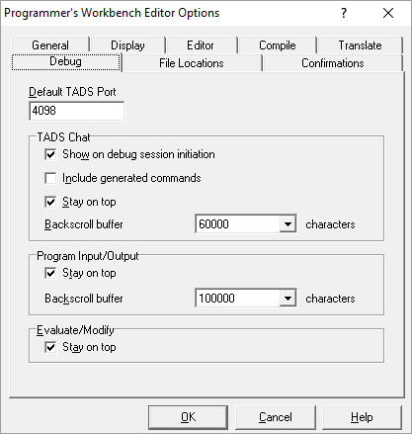
Debugging library and client together.
Get a very big monitor or two smaller ones.
Run two instances of NxEdit
One has the library the other the caller.
On one of the instances go to Tools/Editor Options and change the TADS port. Note that your Windows and MCP firewall might have to be configured to allow this port.
(cont…)
Notes:
It is possible to interactively debug both at once. You’ll want to have lots of screen real-estate.
Run two copies of NxEdit.
Change one of them to use a different port for TADS.

Slide 28
Debugging library and client
Compile each of them
Set breakpoints
Set the library to Debug/Listen mode
Set any attributes either needs
Invoke the client program
When it calls the library the library will stop at the first executable.
Switch windows and do your thing with the library.
When done it will return to the client
Switch back to the other window.
Don’t get confused.
Notes:
Do all the setup that you would normally do for each.
Then invoke the client and start stepping through.
The active window will flip back and forth.

Slide 29
Macros
Macros
Macros are visual basic scripts that can interact with the objects in the NxEdit editor.
Capable of many operations:
Edit the contents of the current file
Compile the current file
Create new files
Create list of families on a host
Create list of directories and files
Can be invoked via assigned Keystrokes, Icons or menu navigation
Notes:
The macros can be very powerful. They aren’t just programmed keys. They are actual programs with variables and conditions.
There are several exported objects with accessible properties and methods. Of course I would like to see others.
They can be assigned to Keystrokes or icons on the menu bar.

Slide 30
Macro Editing
It’s easy to modify existing macros
I find it difficult to add new ones
The editor has a clumsy, non-intuitive interface.
The editor has a very strange font.
Notes:
I just don’t find the interface for adding macros intuitive. It works as explained.

Slide 31
Macros I use
Add begin/end pair
Comment and uncomment several lines
Add a description box
Mark a word

Slide 32
Macros to install
Download the zip file from http://www.goldeyesoftware.com/presentations/ProgWrkbenchMacros.zip
Unzip this to C:\Program Files (x86)\Unisys\MCP\ProgWrkbench
Double click PWBMacros.reg

Slide 33
This presentation
This presentation can be downloaded from http://www.goldeyesoftware.com/presentations/I-Didnt-Know-I-Could-Do-That-With-NxEdit.pptx

